Slide 1

Y. Siva Raju
Digital Marketing Project Phase 2

Slide 2

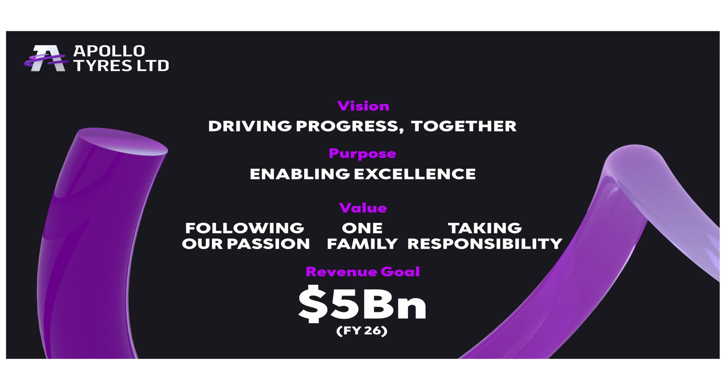
Y.Shiva Raju
Dravidian University
Part 1: Brand study, Competitor Analysis & Buyer’s/Audience’s Persona
Research Brand: Apollo Tyres
Mission/Values:
Following Our Passion: We champion ideas that inspire us to think big, be brave and challenge the ordinary
One Family: We create an inclusive culture that brings our people, partners and community together
Taking Responsibility: We are committed to building a responsible and sustainable business that benefits society
USP: better stability and control in the city and on tricky highway turns.
Analyze Brand Tone and Identity: Apollo Tyres unveils new brand identity to signify focus on sustainable business
Smart Goals and KPIs of Apollo Tyres: Being the early movers in this space, especially in India, and with investments in R&D and Manufacturing towards achieving the 40% sustainable material target by 2030, we have been able to develop this tyre with 75% sustainable materials, which is now being tested extensively before being commercialised.”

Slide 3
Part 1: Brand study, Competitor Analysis & Buyer’s/Audience’s Persona
Brand Study: With the help of innovative campaigns and ads, Apollo Tyres has become a big brand name in the tyre segment. The advertisements of Apollo Tyres emphasize the long life and durability of its product which interests the customers. The company engages in different strategies such as encouraging customers for better driving habits, segmenting customers according to lead ad mileage requirements and running tyre loyalty programs.
Competitor Analysis: MRF is at the top of the tyre manufacturing industry due to their social presence and SEO ranking.
Bridgestone also has a good SEO rank, but it ranks below Apollo Tyres due to its social presence.
Apollo Tyres implements Google ads more compared to JK Tyres.
MRF content on social platforms is quite similar but Apollo advertisements are great
Audience persona’s: Apollo Tyres is one of the largest manufacturers of tyres with operations in India (~67% of sales) & Europe (~31% of sales).

Slide 4

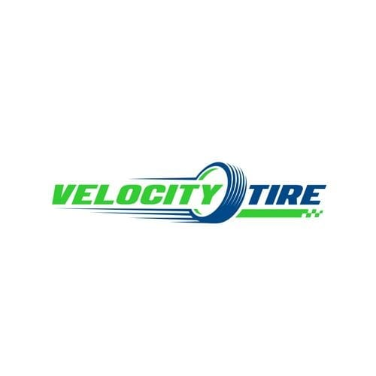
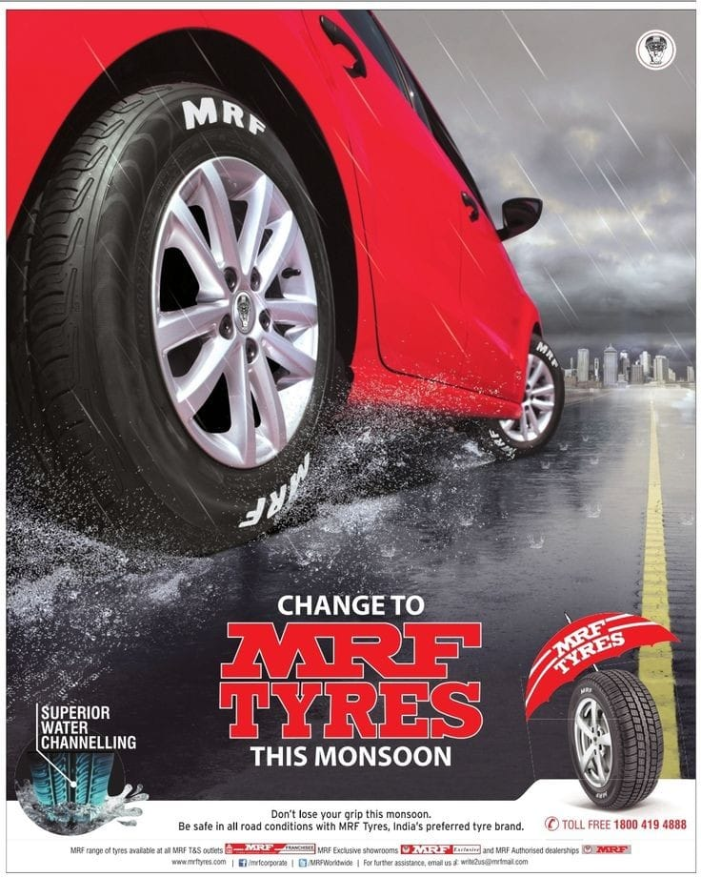
Part 1: Brand study, Competitor Analysis & Buyer’s/Audience’s Persona
SWOT Analysis of different competitors: SWOT Analysis focuses on Strengths, weaknesses, opportunities, and threats of the company. Strength and Weakness are the internal factors and Opportunities and Threats are the external factors which influence the SWOT Analysis.
Competitor 1:CEAT
The company has reported an annual turnover of close to USD 1 billion, with a production capacity of about 95,000 tyres per day.
Competitor 2:Velocity Tyres:
Revenue / turnover of VELOCITY PRIVATE LIMITED is INR 1 cr - 100 cr · Net worth of the company has decreased by -1.90 %
Competitor 3:MRF
The revenues of MRF stood at Rs 196,337 m in FY22, which was up 19.9% compared to Rs 163,731 m reported in FY21.

Slide 5
Part 2: SEO & Keyword Research
Objectives of Keyword research:
The objective of keyword research is to generate, with good precision and recall, a large number of terms that are highly relevant yet non-obvious to the given input keyword. The process of keyword research involves brainstorming and the use of keyword research tools.

Slide 6
Part 3: Content Ideas and Marketing Strategies
Apollo Tyres Promotion Strategy
With the help of innovative campaigns and ads, Apollo Tyres has become a big brand name in the tyre segment. The advertisements of Apollo Tyres emphasize the long life and durability of its product which interests the customers. The company engages in different strategies such as encouraging customers for better driving habits, segmenting customers according to lead ad mileage requirements and running tyre loyalty programs. Some great advertisements or campaigns are as follows:
Social media campaign #RockTheRoad, music was done by DJ Hardwell, won Global Dolphin Award at Cannes
Advertisements related to the personality of a famous person or nature quality are made to show Apollo’s durability
Content Ideas:
We organize GraphQL Summit, the first yearly conference dedicated to GraphQL developers. Summit is the best place to learn how companies are using GraphQL in production, check out the future of the technology, and meet the friendly community working to support and advance it. We're always looking for speakers, so reach out to the Summit team if you're interested in presenting in the future!

Slide 7
Part 3: Content Ideas and Marketing Strategies
Marketing Strategy of Apollo Tyres
Segmentation:
Apollo tyres main segmentation is automobile and industry equipment manufacturers/ OEMs. Their current focus is on Radial and Tubeless types of tyres for passenger cars and vehicle segments.
Target Market:
The target is towards passenger cars, LCV, HCV, SUVs, Agricultural and off the road vehicle manufacturers as well as users and service providers.
Positioning:
Apollo tyres provide a wide range of tyres that caters to various needs for passenger and commercial vehicles. It also provides high performance, high quality, durability and safety. The consumer’s state Apollo Tyres as Value for money because of its high level of technology employed in the products.
The traditional method of marketing i.e. Newspaper, tv ads and billboards.
Pricing the products less than the competitors.
For increasing awareness and contributing towards social as well as environmental issues of the world, they build a foundation to carry out CSR activities.
By adapting the modern method of marketing, they started using unique hashtags for each of their campaigns.
They also promote safety measures to take while driving in their ad campaigns.

Slide 8
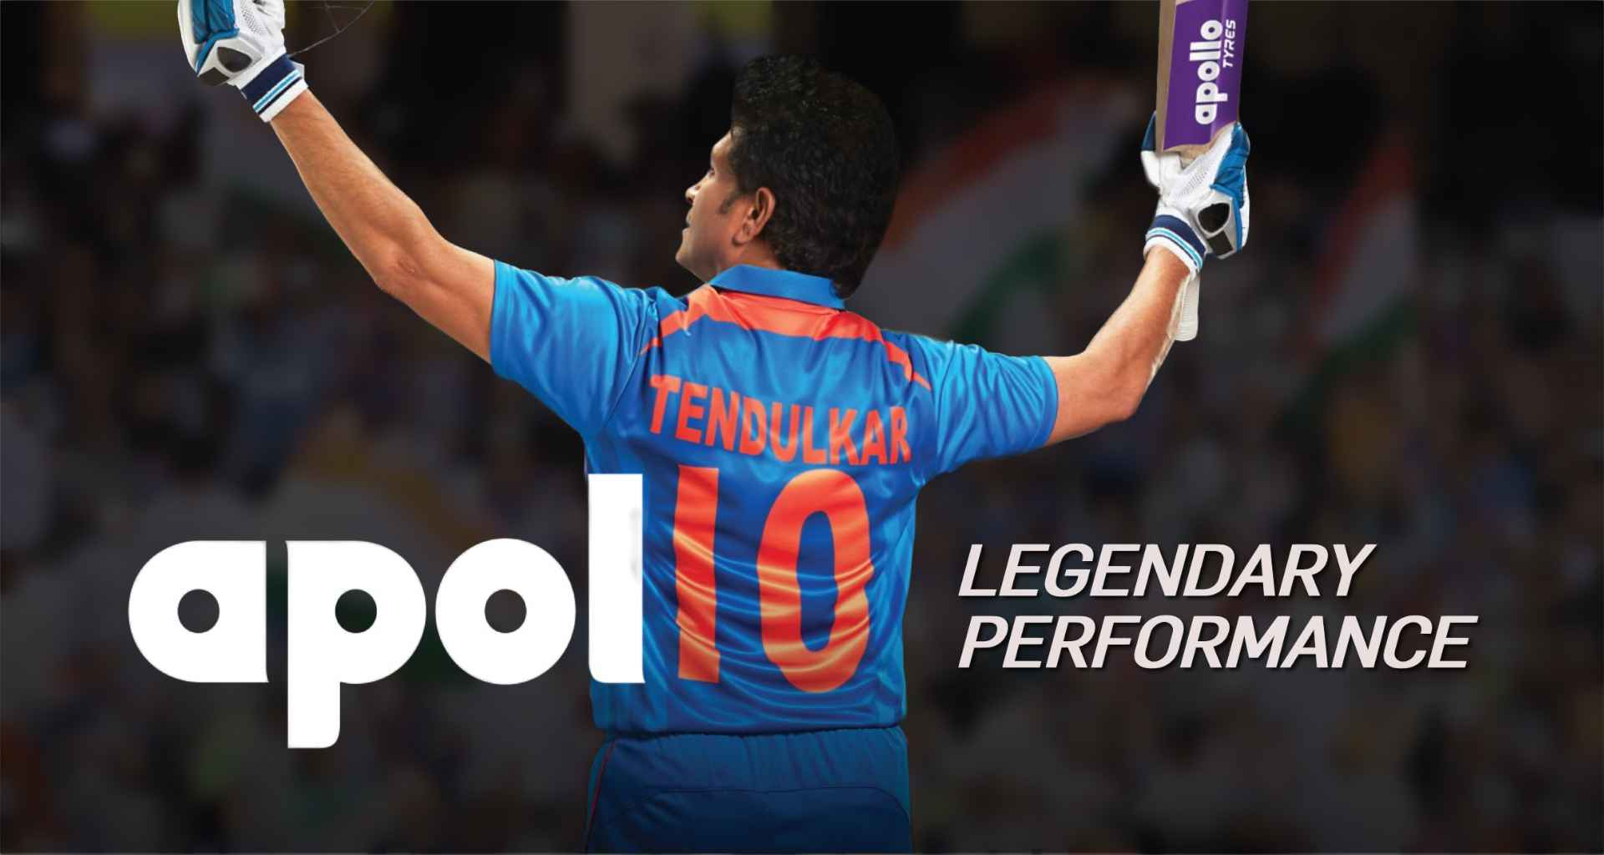
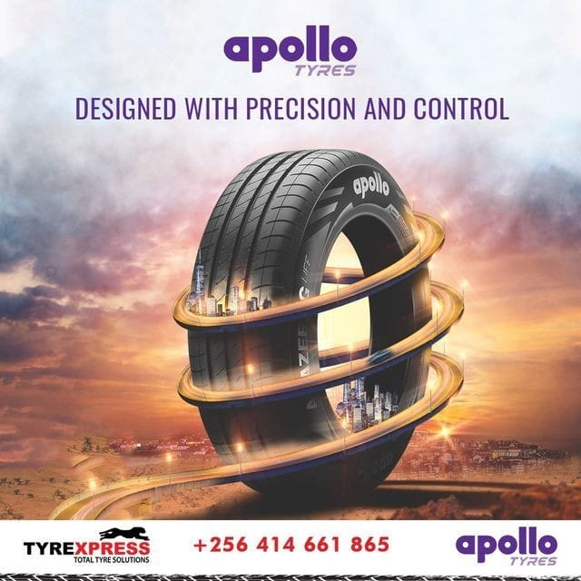
Part 4: Content Creation and Curation
Apollo Tyres social media posts:
https://www.instagram.com/p/Cx4hDvju_rU/?hl=en
https://www.instagram.com/p/CyIZ9I-h2ch/?hl=en

Slide 9
Part 4: Content Creation and Curation
Instagram Story
URL of Instagram story:
https://instagram.com/stories/shivaraju56661/3211183171856833628?utm_source=ig_story_item_share&igshid=NjZiM2M3MzIxNA==

Slide 10
Part 4: Conclusion
APOLLO TYRES
Apollo Tyres as a brand has its own unique story on the road to success. The brand is sticking to its essence when it comes to connecting to its audience through its educational as well as innovative advertisements. With the upcoming digital technology, the brand’s loyal services are what gains them the most customers. Along with that, their marketing strategies are also improving.
We all know that the importance of Digital marketing has increased tremendously over years. Each industry’s marketing strategy includes exceptional branding on digital platforms to make themselves more visible nowadays. If you are interested in expanding your skills or keen to learn Digital Marketing, then IIDE provides many short-term as well as long-term courses too. Just sign up for the course and learn from top digital experts.
Thank you for taking the time to read the blog. Any suggestions are welcomed in the comment section. Also, share and educate your friends with the knowledge. Hope you have a great day ahead.

